Slide 1
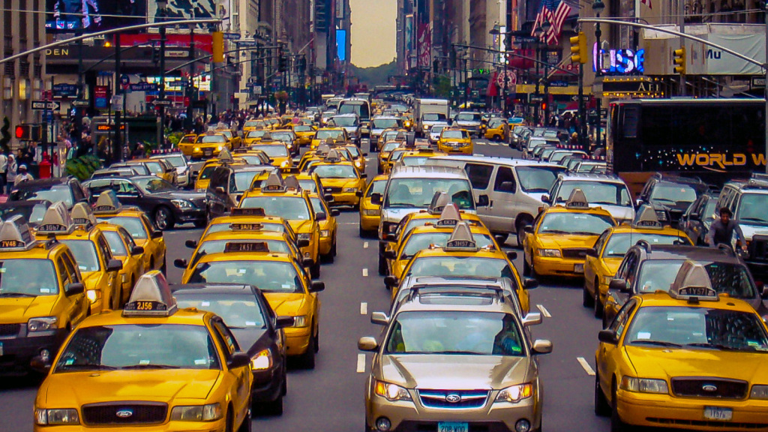
Studying Street Safety in NYC
Jordan Zandi & Jason Goode
Final Project, MPCS 53120
Due: 5/29/18

Slide 2
Contents
Overview
Data
Methods/Analysis
Results
Interpretation

Slide 3
Overview
Overview
Introduction: Vision Zero is NYC’s primary policy initiative to reduce traffic-related injuries and fatalities. This includes street design, outreach, enforcement, legislation, and campaigns. We are focused on street design
Objective: Study the relationship between NYCDOT’s street design safety measures and traffic-related injuries/fatalities
Hypothesis: NYCDOT’s traffic safety initiatives have a statistically significant reductive impact on the odds of fatality and the incidence of injury.

Slide 4

Data (Accidents)
Data
Source:
Description: 4 CSVs of fatality and injury counts by month, year, and type.
Includes latitude and longitude coordinates of nearest intersection where accident occurred
41,466 injuries occurred in NYC in 2016

Slide 5
Data (Accidents)
Data
Month
Bike Injuries (Plotted) by Month

Slide 6
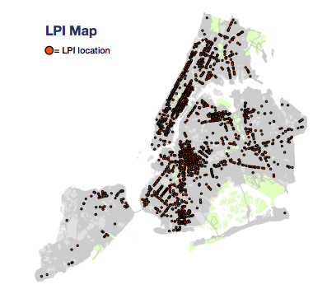
Data (GeoSpatial)
Data
Source:
Description:
Basemap: Shapefile (.shp) coordinates of every street and intersection in NYC
Street Attributes: 14 GeoJSONs that map locations of street attributes
EX: Leading Pedestrian Intervals
We recorded 128,000 intersections in NYC

Slide 7
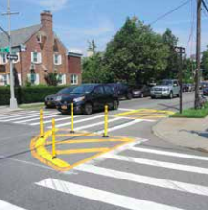
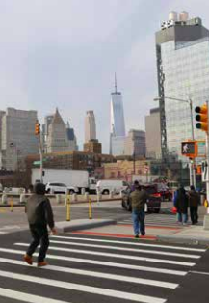
Data (Predictors & Outcomes)
Data
Predictors
Arterial Slow Zones
Enhanced Crossings
Leading Pedestrian Intervals
Street Improvement Corridors/Intersections
Left Turn Traffic Calming
Speed Humps
Safe Streets for Seniors
Neighborhood Slow Zone
Month
Enhanced Crossing
Slow Zones
Leading Pedestrian Interval
Outcomes
Cyclist
Injuries / Fatalities
Motor Vehicle
Injuries / Fatalities
Pedestrian
Injuries / Fatalities

Slide 8
Wrangling GeoSpatial Data
Data
Generate Basemap of Intersections
Map Intersections to Accidents
Map Intersections to Attributes
Intersection (x,y)
Equals?
Lies within?
Lies on?
Polygon
LineString
Point
(x,y)
Binary Classification (T/F)

Slide 9
Methods
Analysis
Multiple Logistic Regressions: Observe relationship between street attributes and occurrence of injury on street intersections
All_Injuries
Bike_Injuries
Ped_Injuries
MVO_Injuries
Prediction: Predict probability of accident occurring on any given street intersection
GLM Fit
Decision Trees

Slide 10
Results (Odds Ratios)
Results
All Injuries
Odds ratios suggest that predictors increase likelihood of injury
Significant Predictors
Arterial Slow Zones
Leading Intervals
Left turn traffic calming
Safe Streets for Seniors
Speed Humps
Street Improvement Corridors

Slide 11
Results (Odds Ratios)
Results
Pedestrian
Significant Predictors
Arterial Slow Zones
Speed Humps
Left Turn Traffic Calming
Leading Pedestrian Intervals
Street Improvement projects

Slide 12
Results (Odds Ratios)
Results
Bicycle
Significant Predictors
Bike Priority Districts
Speed Humps
Left Turn Traffic Calming
Arterial Slow Zones
Signal timing
Street Improvement Projects
Neighborhood Slow Zones

Slide 13
Results (Odds Ratios)
Results
Motor Vehicle
Significant Predictors
Arterial Slow Zones
Left Turn Traffic Calming
Speed Humps
Street Improvement Projects
Neighborhood Slow Zones (our only odd’s ratio < 1.0)

Slide 14
Results (Prediction)
Results
Area Under Curve (AUC)
Category | Value
AUC | 0.71
Accuracy | 0.42
Cutoff | 0.1
Sensitivity (TPR) | 0.75
Specificity (1- FPR) | 0.34

Slide 15
Results (Decision Tree/ Random Forest)
Results
Decision Tree
Variables of Importance*
(Leading Pedestrian Intervals, Street Improvement Projects, Signal Timing)
*Same top 3 variables of importance for tree and forest
Tree AUC = 0.64
RF AUC = 0.66
There is little difference between tree and random forest AUC, with both worse than the simple GLM fit prediction
Notes:
TREE - Each node shows –
the predicted class (0/1),
the predicted probability of 1,
the percentage of observations in the node.

Slide 16
Interpretation
Interpretation
Our hypothesis: We thought that safety initiatives would decrease risk of injury
Our results: Presence of initiatives increase incidence of injury. Counterintuitive!
Interpretation:
Initiatives were more likely to be implemented in accident-prone areas
Some predictors were simply designated “hot zones” (further categorization did not correct for this)
Lack of time-series data
Weather (did not have exact date)
Month (We had months of accident nodes, but not all other nodes)
Significance is misleading due to very high n (# of intersections), which reduces SE
Reflection: What would we do differently?
Find out when initiatives were implemented, do a comparison of injury count before and after for all intersections across multiple years (much more involved)
Include some harder-to-parse and imperfect predictors (e.g. average speed)

